Slide 1
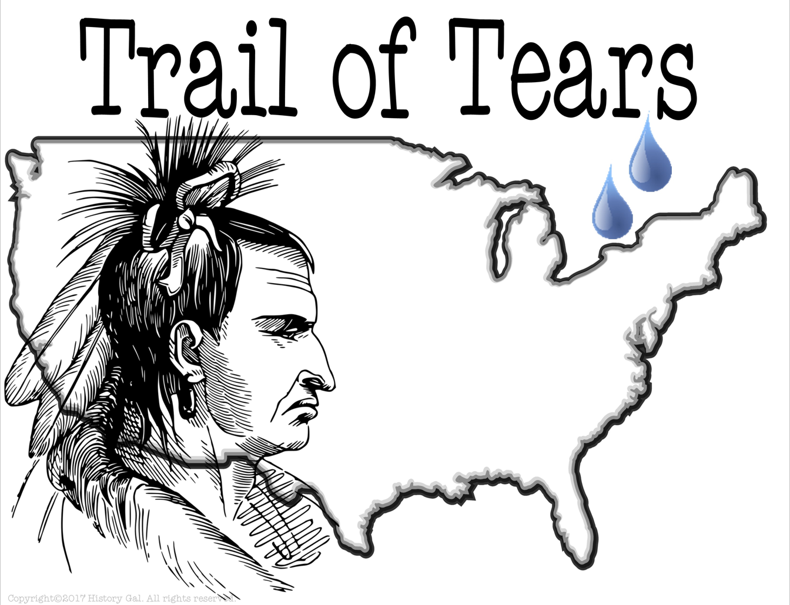
Native American Relocation research project
How did Native American relocation impact westward expansion in the united states?

Slide 2
The project
So much WORK!!!
Andrew Jackson Information Chart – Level 2
Chief Joseph Information Chart – Level 2
Independent Research Chart – Level 2.5
RAFT Essay – Level 3
Final Essay Question – Level 4

Slide 3
Primary sources vs. secondary sources
What is a primary source?
What is a secondary source?
Where can you find primary sources?

Slide 4
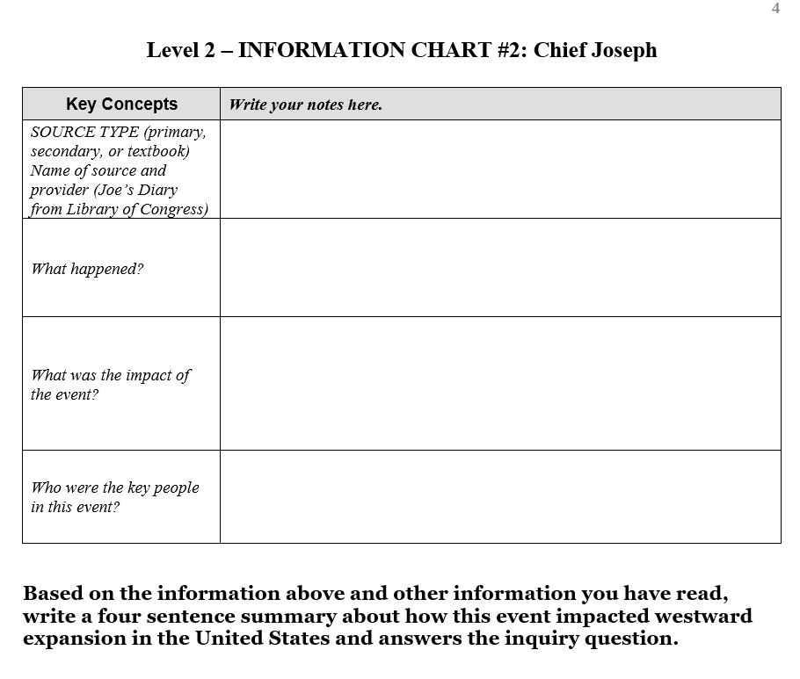
Primary sources
Primary sources created by President Andrew Jackson of the United States and Chief Joseph of the Nez Perce

Slide 5
Now its your turn… finding a secondary source.
This Photo by Unknown Author is licensed under CC BY-NC-ND

Slide 6
Keywords
Watch the video clip and then list 5 – 10 keywords and phrases you could use when searching for information. Do not go on until you have completed this part.
This Photo by Unknown Author is licensed under CC BY-SA

Slide 7
AT HOME LOGIN: omahaps PASSWORD: omahaps
AT HOME PASSWORD: ops

Slide 8
NAVIGATING YOUR RESOURCES
CLICK HERE FOR THE MARRS LIBRARY RESOURCE PAGE
Click play to start the video instructions.

Slide 9
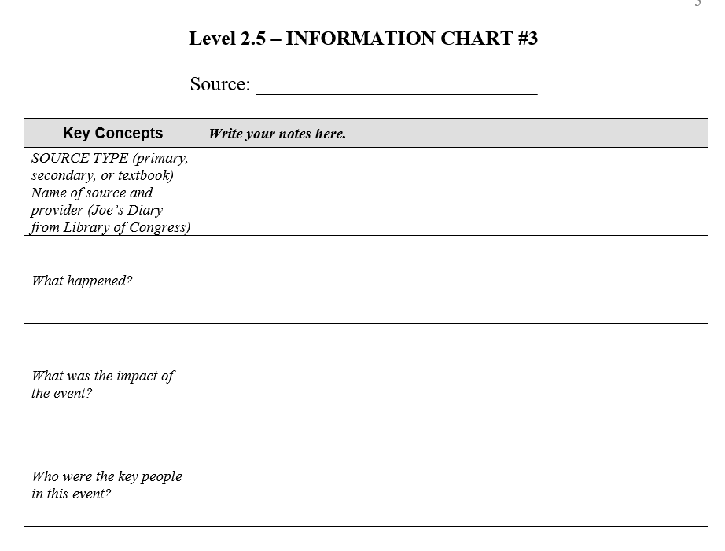
You found a good article
Fill out the bottom box with the name of the database you selected your article from, the title of the article, and the author if it’s available.
Read the article and take notes on page 5 of your packet. Is this a primary or secondary source? Make sure to answer each question on the graphic organizer.

